Slide 1
IPSEOA L. PETRONIO
POZZUOLI- NAPOLI
Notes:
1

Slide 2
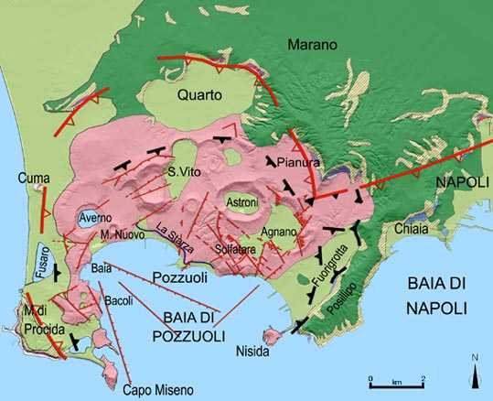
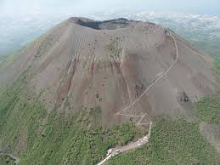
POZZUOLI
VESUVIO
Notes:
2

Slide 3
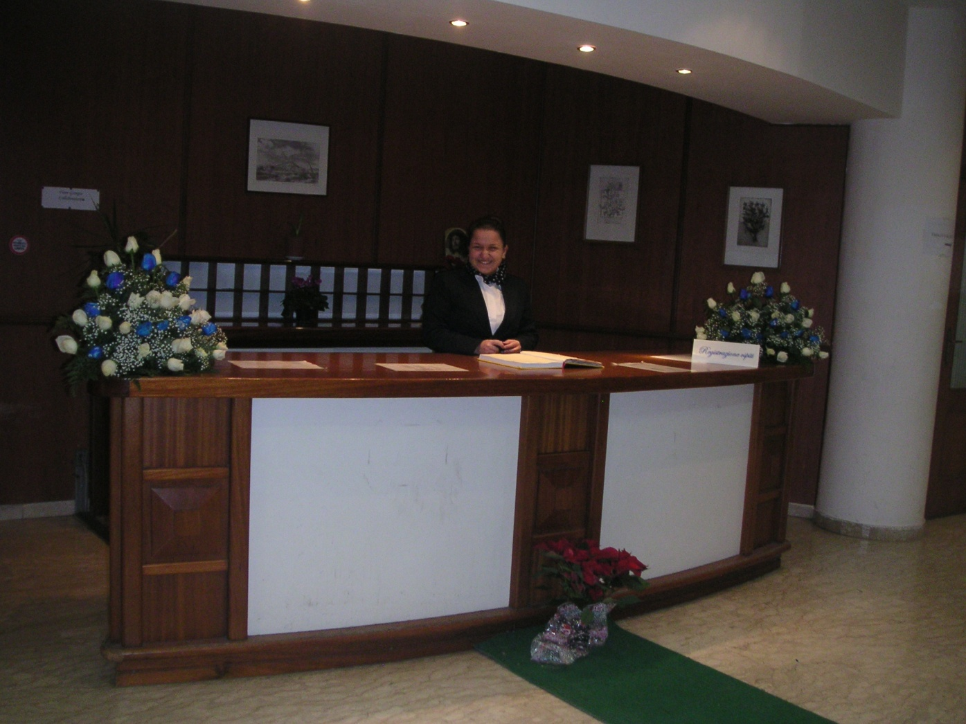
WELCOME
Notes:
3

Slide 4
Our history
Our school has located in the territory of Monterusciello (Pozzuoli neighborhood built after the earthquake in the 1980s) since 1986 as subsidiary of the IPSSAR (Istituto professionale per i servizi alberghieri e la ristorazione) in Naples.
In September 1991, as the number of students increased, this school moved to a new building in the same area, and in 1992 it became an autonomous school.
Notes:
4

Slide 5
IPSEOA L. Petronio in Monterusciello
The offices, the principal’s office and the library are located on the first floor.
Vice-Principal’s room and teachers‘ room are on the ground floor.
There are 16 laboratories and 33 classrooms. There is a covered gym with a regular basketball court, changing rooms and bleachers.

Slide 6
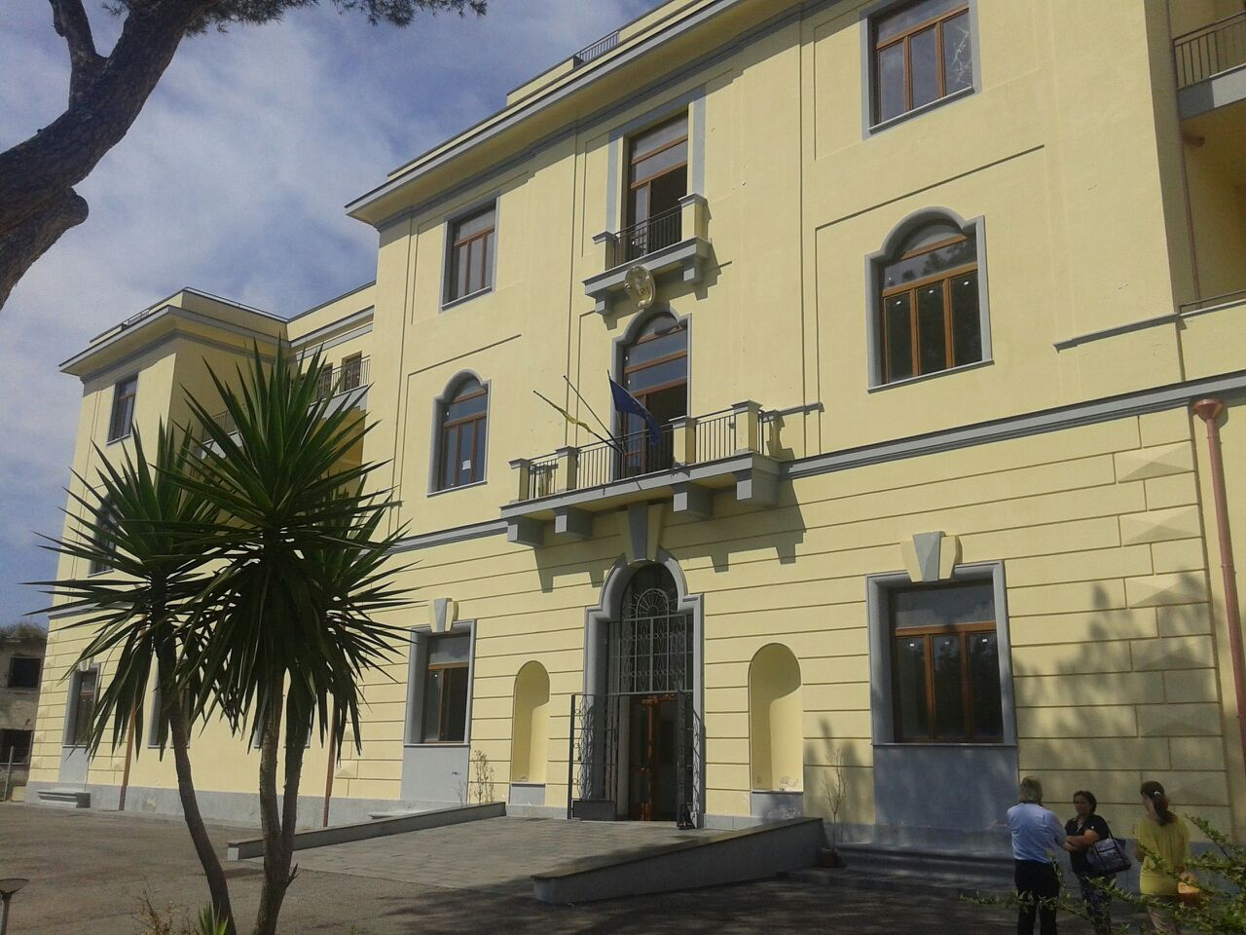
In 2013, a new prestigious site was found in Pozzuoli as the number of students increased again.
Notes:
6

Slide 7
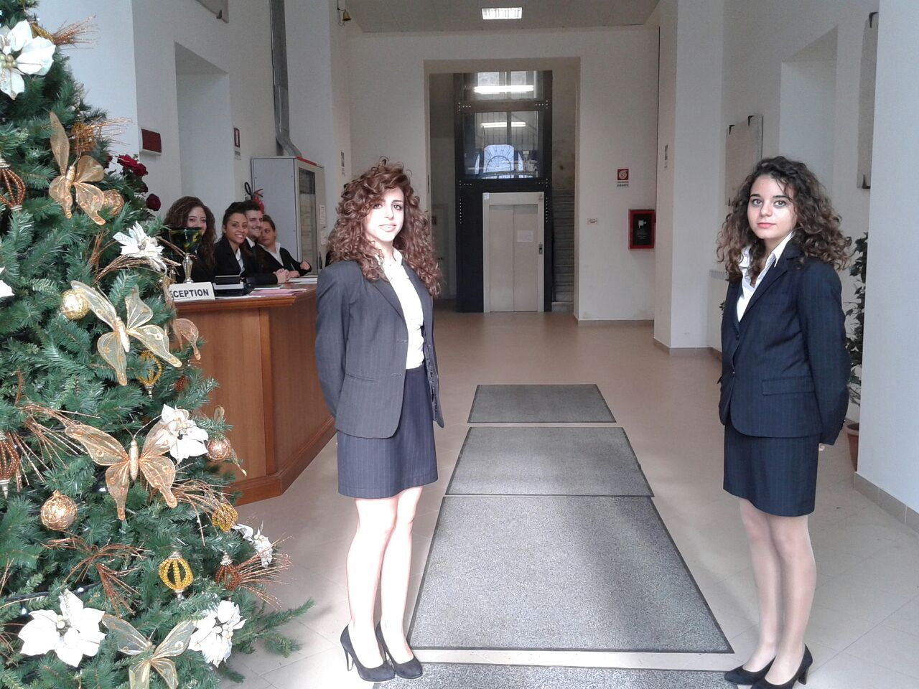
IPSEOA L. Petronio in Pozzuoli
• The principal’s office is located on the ground floor.
• Vice-Principal’s room and teachers‘ room are on the first floor
• There are 3 laboratories and 29 classrooms
• Bar and Kitchen laboratories
• Video room

Slide 8
Our Mission
«Person, training and hospitality: a way to every passion»
School-work alternation (400 hours in 3 years);
Internship;
Soft Skills training;
Cooperation;
Inclusion and integration.

Slide 9
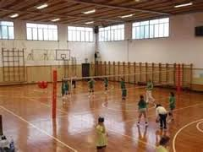
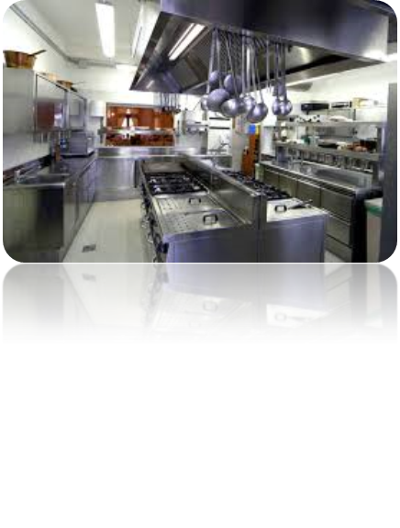
Our school
Nowadays, our school has got 62 classrooms and about 1300 students from 14 to 19 years old.
Our Principal is Mr. Filippo Monaco.
Notes:
9

Slide 10
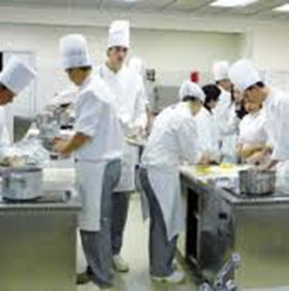
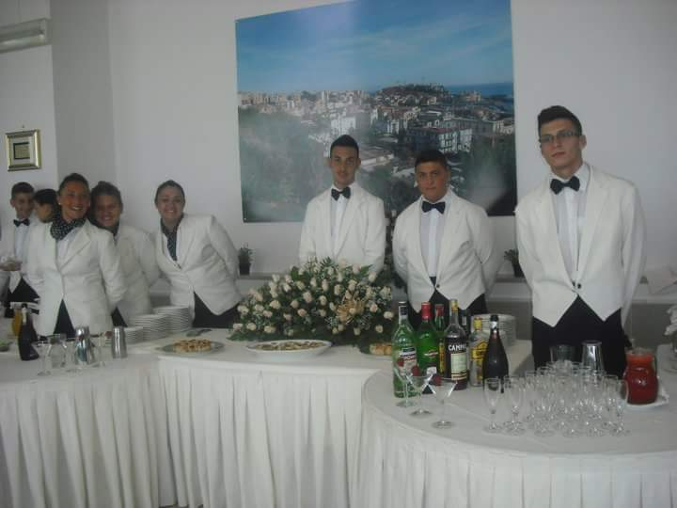
Actually, our school offers the following vocational pathways :
Enogastronomy (Chef and Pastry chef)
F&B Service and Sales (Maître, Head waiter, barman, Bar/Restaurant manager).
Notes:
10

Slide 11
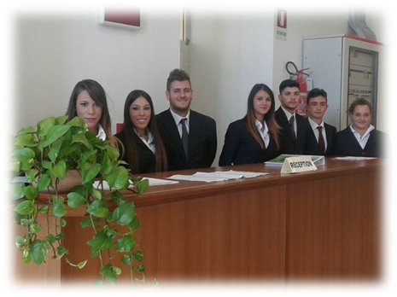
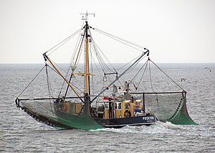
Tourist reception (receptionist, tourist information officer, tour guide)
Commercial fishing and fish productions since the school year 2019/20

Slide 12
Our basic guidelines
developing professional profiles, in line with the requirements of the labour market;
enrichment of the educational role of the school;
- development of knowledge, skills and abilities to let each student building his/her personal way to work;
- promotion of school success, through training and re-training activities;
- implementation of quality-based learning, especially learning by doing.
Notes:
12

Slide 13
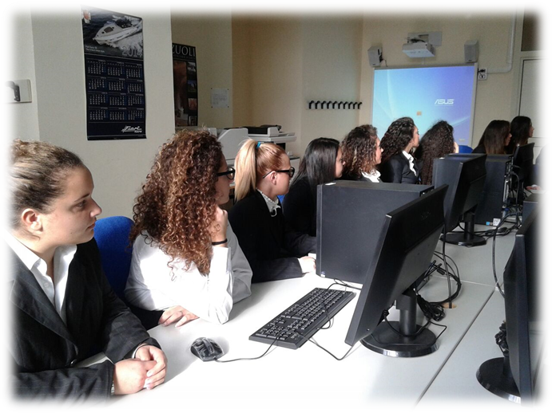
All trainings are combined with the acquisition of language skills in various foreign languages, such as English, French, German, Spanish and computer skills.

Slide 14
Our students have to face two examinations.
The first one is at the end of the third year
The second one is at the end of the fifth year
which allows students to start university.
Vocational Qualification
Esame di Stato
(Secondary school leaving qualification )
Notes:
14

Slide 15
University faculties
After the fifth year qualification, our students can continue their academic career and get their degree in:
Hospitality
Foreign languages
Food Science and Nutrition
Tourism management and marketing

Slide 16
Sights & Landmarks in Pozzuoli Rione Terra and Temple of Augustus
This quarter, rising steeply above the sea, was the oldest centre of the Greek city, the Acropolis, the citadel and the religious centre.
In 1970 because of the phenomenon of bradyseism, the quarter was evacuated and after a long period the works have started.
At present, tourists can visit a long stretch of the subterranean archaeological route.
Notes:
16

Slide 17
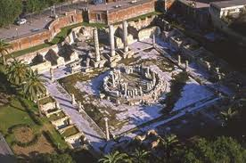
Macellum or Temple of Serapis
During the excavations, which were begun in 1750, in this old city market ,a statue of the Egyptian God Serapis was found and therefore the edifice was called temple mistakenly. The three columns of grey cipolin bear traces of the holes made by sea shellfish show the effects of bradyseism.

Slide 18
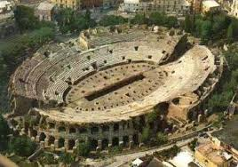
Flavian amphitheatre
Flavian amphitheatre is the third largest amphitheatre ever built by the Romans. The dungeons were the heart of the amphitheatre, and from there people and animals were transport up to the arena and then started their battle, sometimes the arena was filled with water and recreate naval battles.
There is also a legend concerning the amphitheatre about Saint Januarius, who was condemned to be eaten alive by a beasts, but the beasts didn't eat him and knelt near his feet, however then he was killed in the Solfatara volcano and since then he became the patron of Naples.
Notes:
18

Slide 19
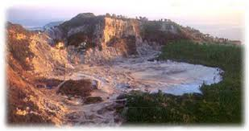
The Solfatara volcano
The Solfatara of Pozzuoli is located three kilometres far the centre of Pozzuoli.
It is still an active volcanic crater.
In the crater, there are jets of sulphurous steam called “fumarole”, boiling mud and gas emissions, an elevated temperature of the ground.
In 1198 A. D., there was a disastrous eruption, told by Scipione.
Since 1900 visits have effected inside the crater.
Notes:
19

Slide 20
Lake Avernus (it means without birds)
It is a lake of volcanic origin located in the Phlegraean Fields in the Campania region in southern Italy, about 4 km west of Pozzuoli.
Curiosity !!!
Lake Avernus was considered by the Romans to be the entrance to Hades. In Virgil's
Aeneid, Aeneas descends to the underworld through a cave near the lake.

Slide 21
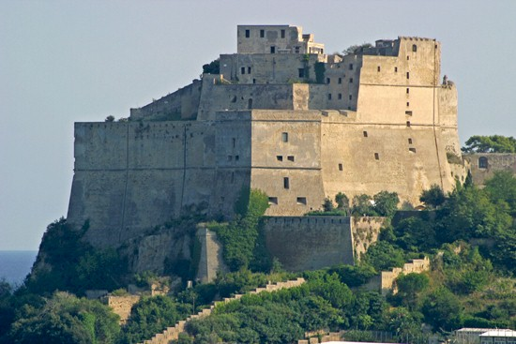
The Aragonese Castle
The Aragonese Castle is located in Baia, a small town near Bacoli, on the northwest shore of the Gulf of Naples. It was built by Aragonese people on a promontory overlooking the sea.
The fortress was enlarged by the Spanish viceroy, don Pedro de Toledo after the eruption of Monte Nuovo (1538 A.D.).
Today, a part of the castle houses an archaeological museum.

Slide 22
Thank you for your attention
Jerez de la Frontera, Spain
11 -14 February,
Erasmus+

